Slide 1
Clock Circuitry
The processor has to be given the clock input to one of the pins.
To generate the clock signal, a crystal oscillator are required.
For some processors, the oscillator circuitry is in-built. And for some external circuit is added.
All processor events are related to the clock. The higher the clock frequency, the higher the speed of the processor.

Slide 2
Cycle
Instruction Cycle
Machine Cycle
Clock Period

Slide 3
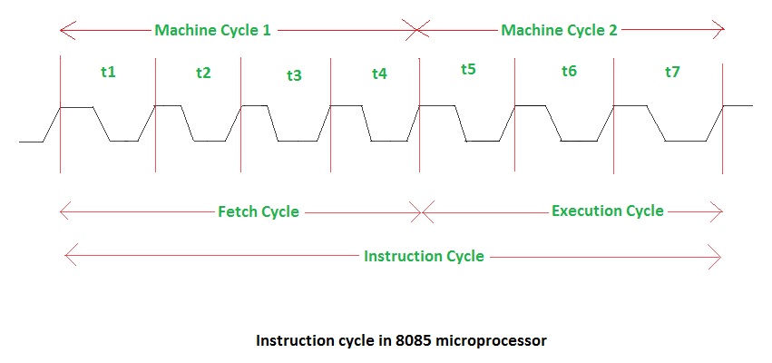
Cycle

Slide 4
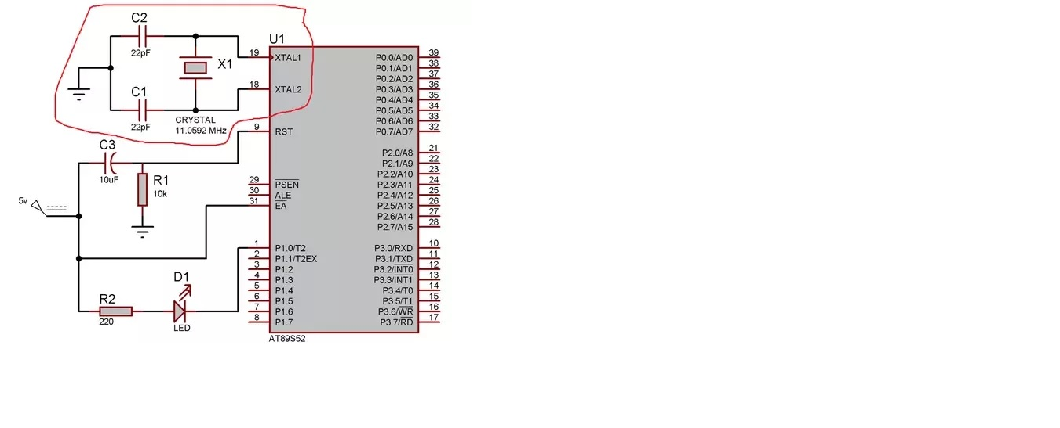
8051 microcontroller connected with crystal oscillator

Slide 5
Clock Circuitry
The CPU takes a certain number of clock cycles to execute an instruction. In the 8051 family, these clock cycles are referred to as machine cycles.
In the 8051 family, the length of the machine cycle depends on the frequency of the crystal oscillator connected to the 8051 system.

Slide 6
Clock Circuitry
The frequency of the crystal connected to the 8051 family can vary from 4 MHz to 30 MHz, depending on the chip rating and manufacturer.
Very often the 11.0592 MHz crystal oscillator is used to make the 8051 -based system compatible with the serial port of the IBM PC

Slide 7
Clock Circuitry
In the original 8051, one machine cycle lasts 12 oscillator periods. Therefore, to calculate the period of machine cycle for the 8051, we take 1/12 of the crystal frequency, then take its inverse.

Slide 8
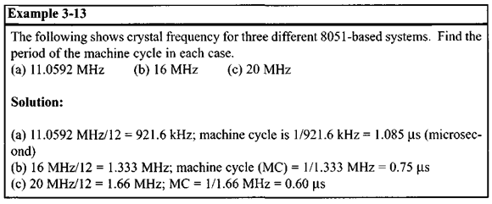
Clock Circuitry

Slide 9
Clock Circuitry
Advances in CPU design in recent years have increase the 8051 performance.
The number of machine cycles and the number of clock periods per machine cycle varies among the different versions of the 8051 microcontrollers.
While the original 8051 design used 12 clock periods per machine cycle, many of the newer generations of the 8051 use much fewer clocks per machine cycle.

Slide 10
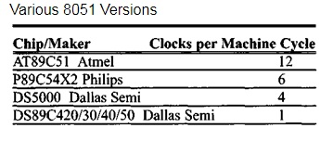
Clock Circuitry

Slide 11
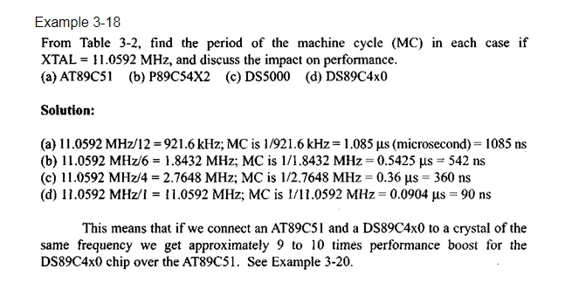
Clock Circuitry

Slide 12
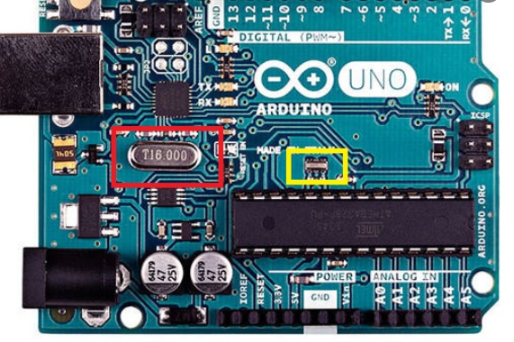
Clock Circuitry

Slide 13
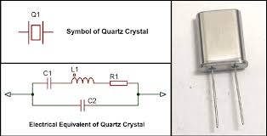
Clock Circuitry

Slide 14
Watchdog Timer/Reset Circuitry
Self Reliant System.
Most of the embedded systems do not have a reset button. Due to some software or hardware error, there is need to reset the processor.
A watchdog timer or simply a watchdog, is a hardware timer for monitoring the firmware execution.
In this case, a timer is set to a large value and it is decremented slowly. If the timer value reaches zero, the processor is reset through the signal. If everything is fine and healthy, the timer value is again set to the large value.

Slide 15
Watchdog Timer/Reset Circuitry
In some case if reset button is provided and is pressed than a reset signal is sent to the processor.
Most of the processors implement watchdog as a built-in component and provides status register to control the watchdog timer. If the processor doesn't contain a built in watchdog timer, the same can be implemented using an external watchdog timer IC circuit.

Slide 16
Watchdog Timer/Reset Circuitry
Watchdog timer is used to regain control when a system has failed due to software error or due to failure of an external device to respond in the expected way.
A watchdog timer can generate a NMI or a RESET when a time out value is reached.

Slide 17
Watchdog Timer/Reset Circuitry
The STWD100 watchdog timer circuits are self-contained devices which prevent system failures that are caused by certain types of hardware errors (such as, non-responding peripherals and bus contention) or software errors (such as a bad code jump and a code stuck in loop).

Slide 18
Watchdog Timer/Reset Circuitry
The STWD100 watchdog timer has an input, WDI, and an output, WDO .
The input is used to clear the internal watchdog timer periodically within the specified timeout period, t(wd).
While the system is operating correctly, it periodically toggles the watchdog input, WDI.
If the system fails, the watchdog timer is not reset, a system alert is generated and the watchdog output, WDO , is asserted.
The STWD100 circuit also has an enable pin, EN , which can enable or disable the watchdog functionality.

Slide 19
Watchdog Timer/Reset Circuitry

Slide 20
Watchdog Timer/Reset Circuitry

Slide 21
Watchdog Timer/Reset Circuitry
The STWD100 device is used to detect an out-of-control MCU. The user/program has to ensure watchdog reset within the watchdog timeout period, otherwise the watchdog output is asserted and the MCU is restarted.
The STWD100 can also be enabled or disabled by the chip enable pin.
The WDI input has to be toggled within the watchdog timeout period, t(wd), otherwise the watchdog output, WDO , is asserted.
If the timer is not cleared within the t(wd), , the WDO goes low.
States "Watchdog input (WDI)" and "Watchdog output ( WDO )" are valid under the condition that EN is in logical low state.

Slide 22
Watchdog Timer/Reset Circuitry
Link(Forum)
https://www.embedded.com/introduction-to-watchdog-timers/#

